Slide 1


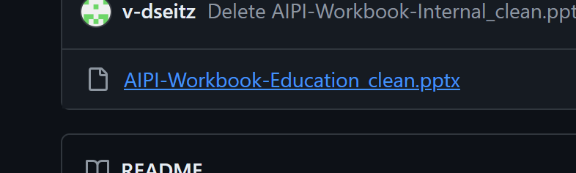
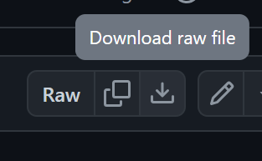
AI-powered Innovation Using AI to accelerate your Innovation Piali Ghose – Sr Director, Garage Reston DC Daniel Seitz – Lab Manager, Garage Reston DC
Download this workbook from:
aka.ms/restonAIPI

Slide 2

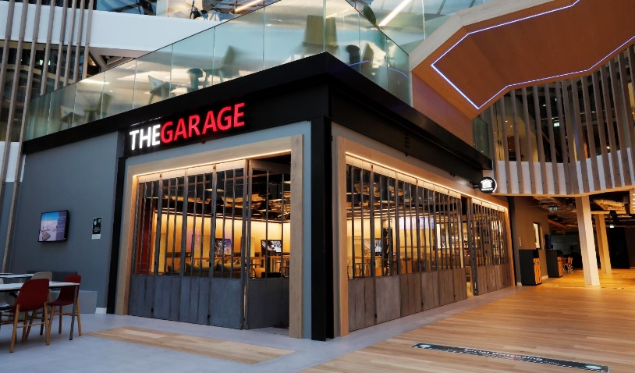
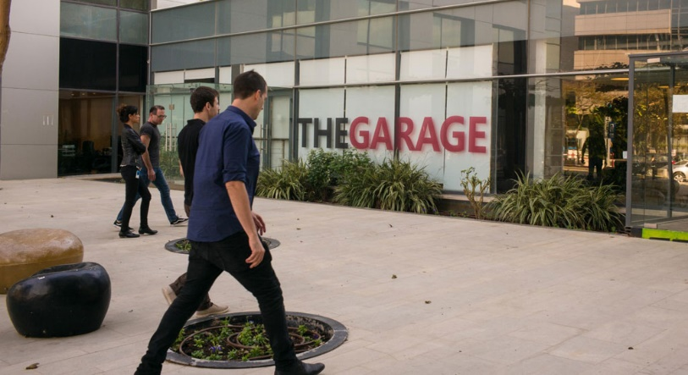

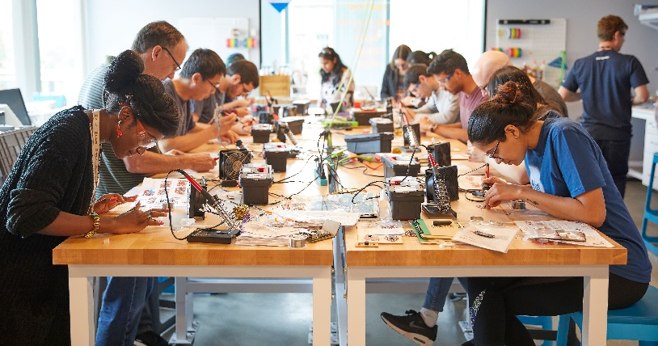


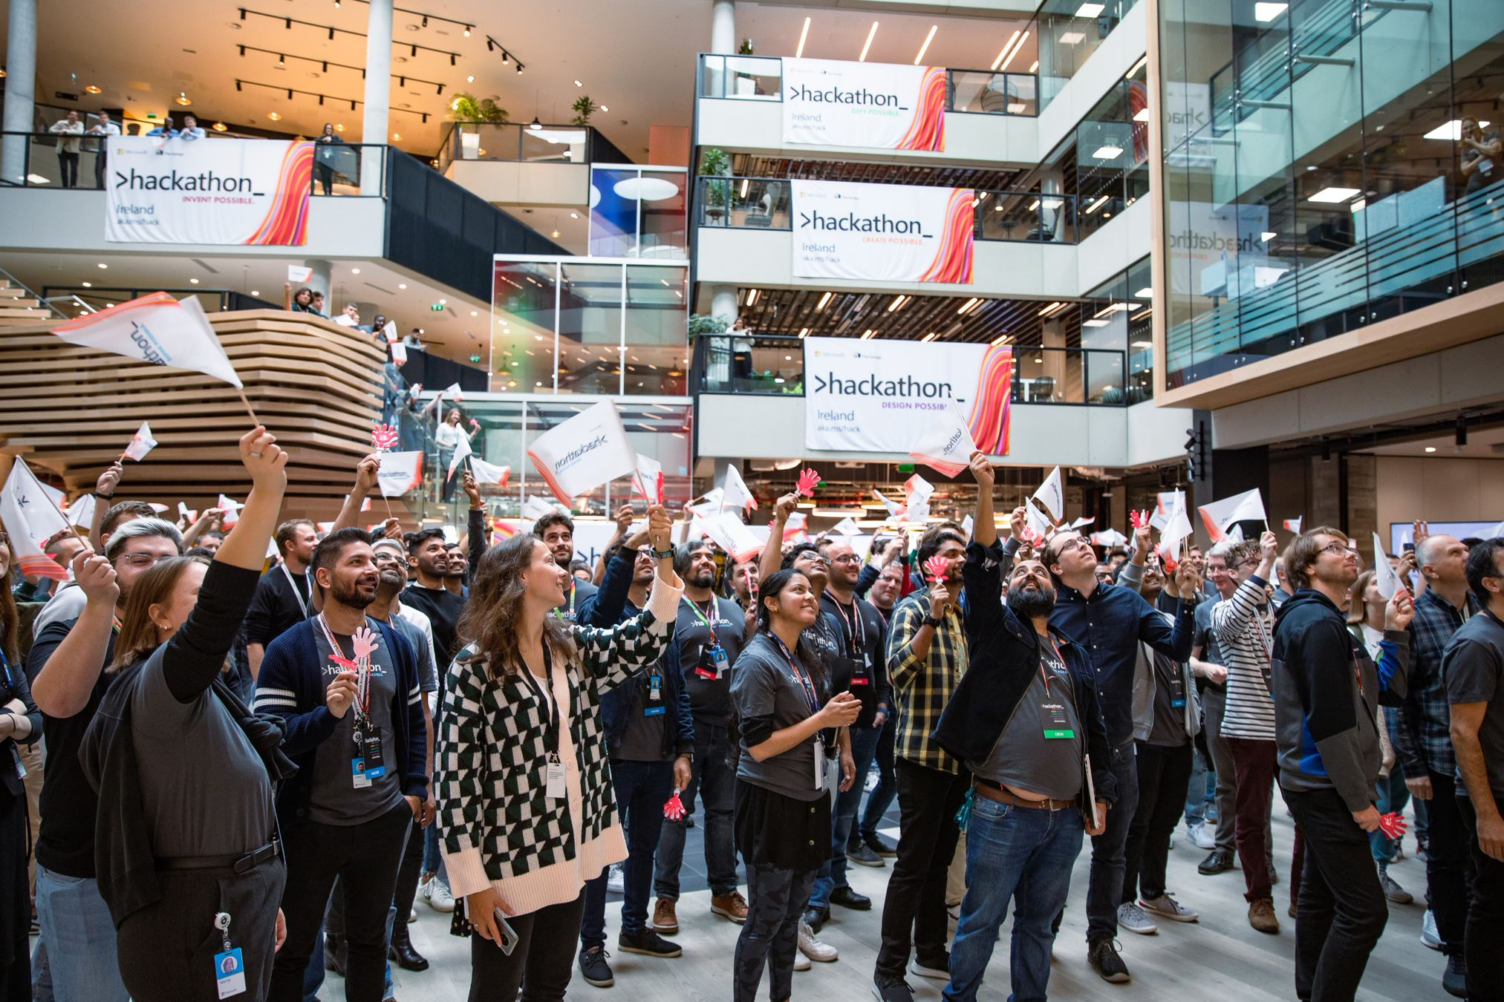
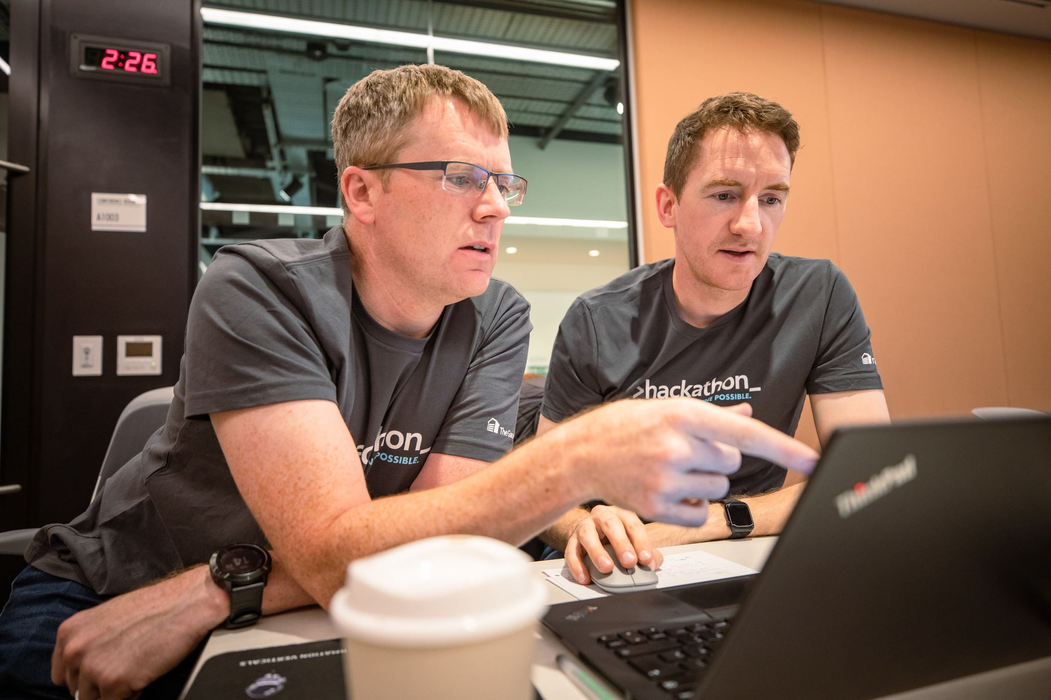

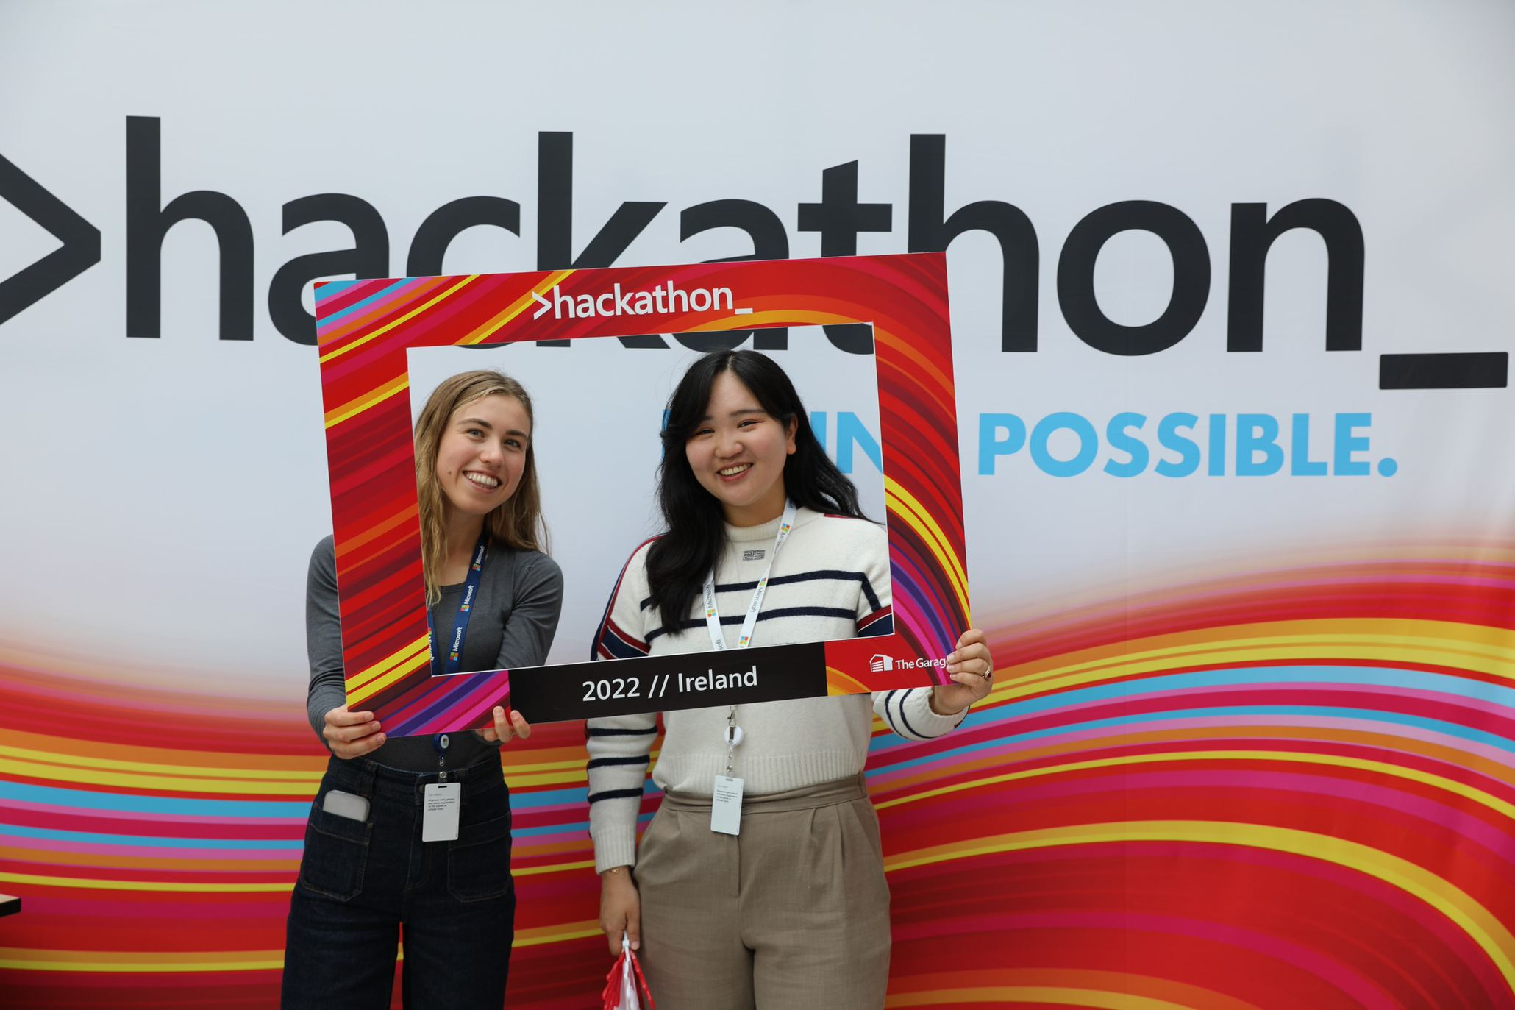
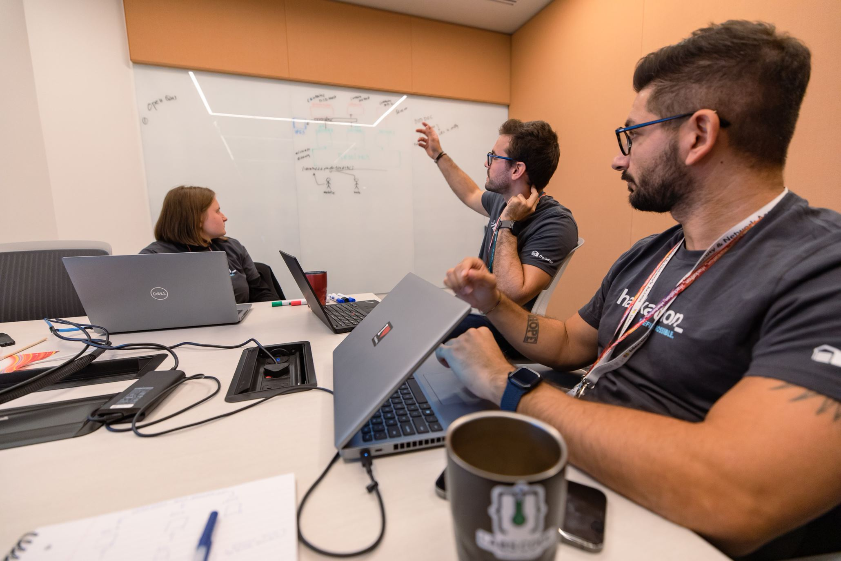
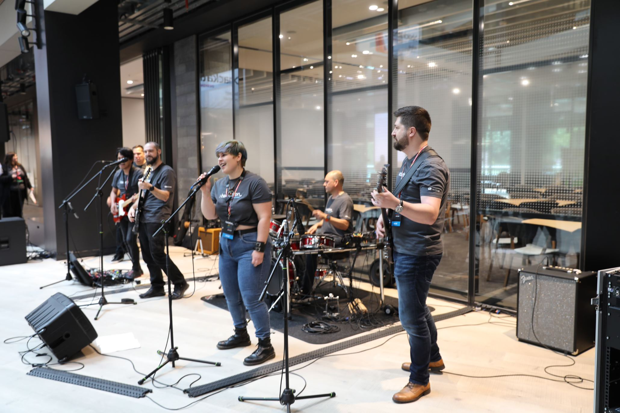
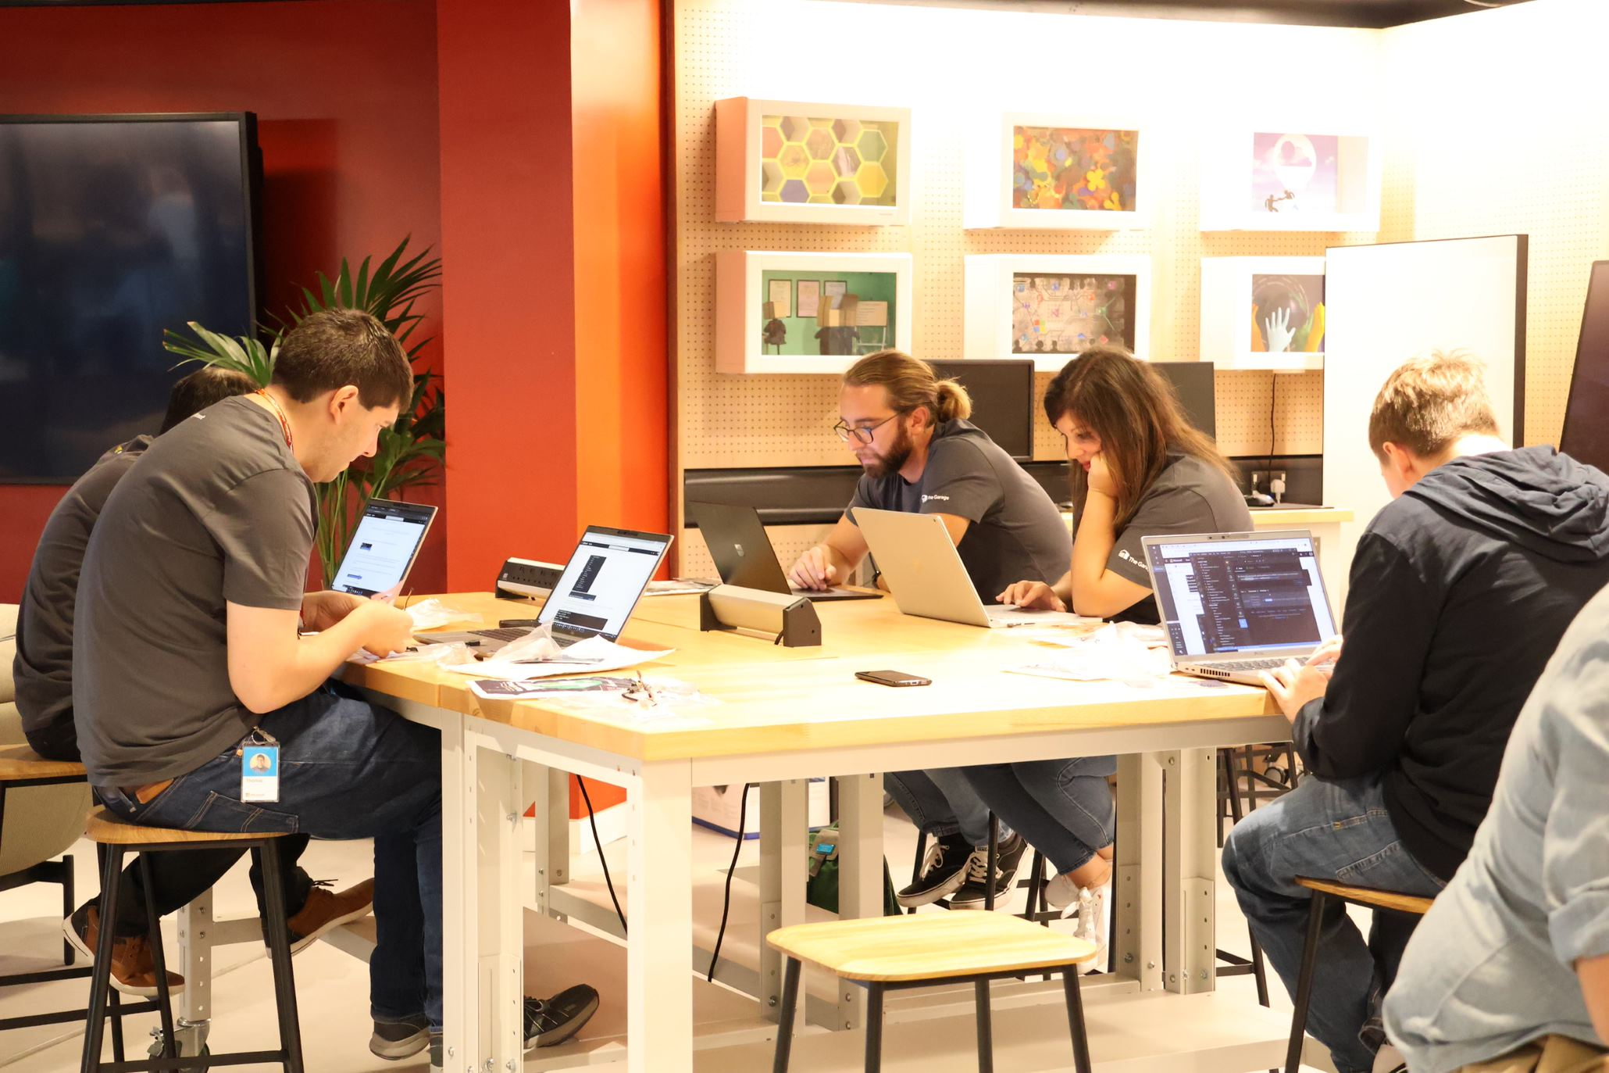
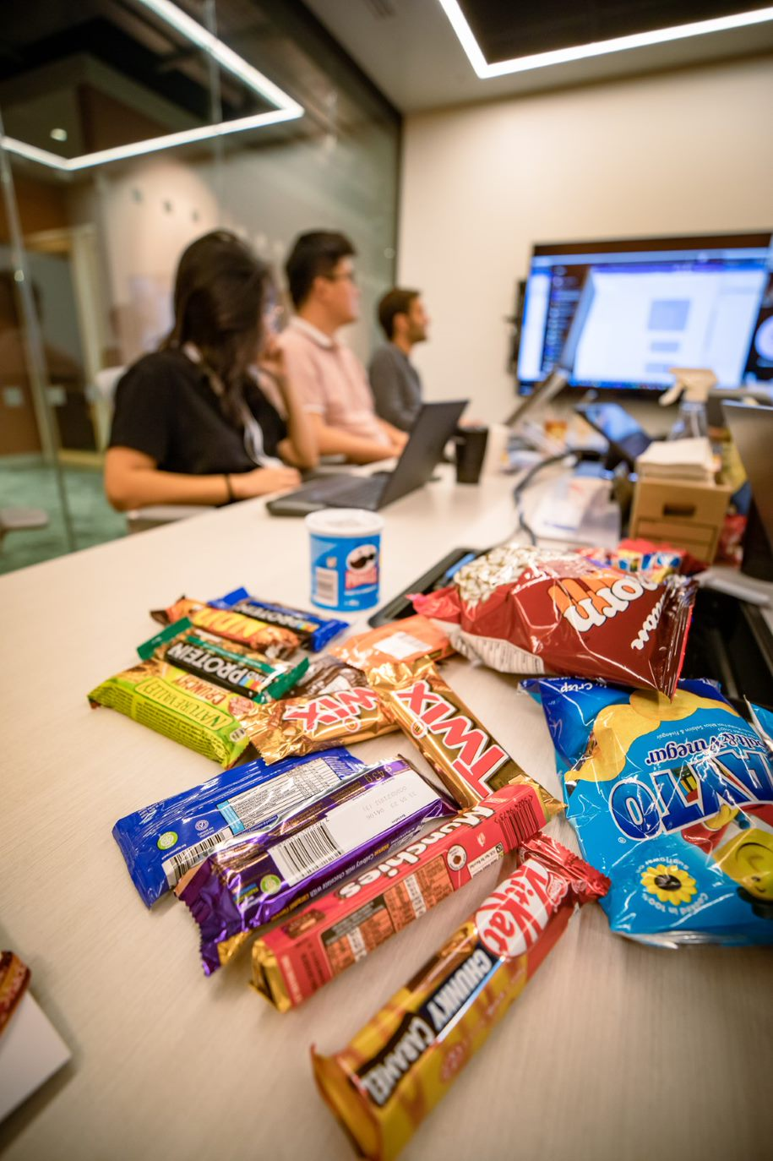
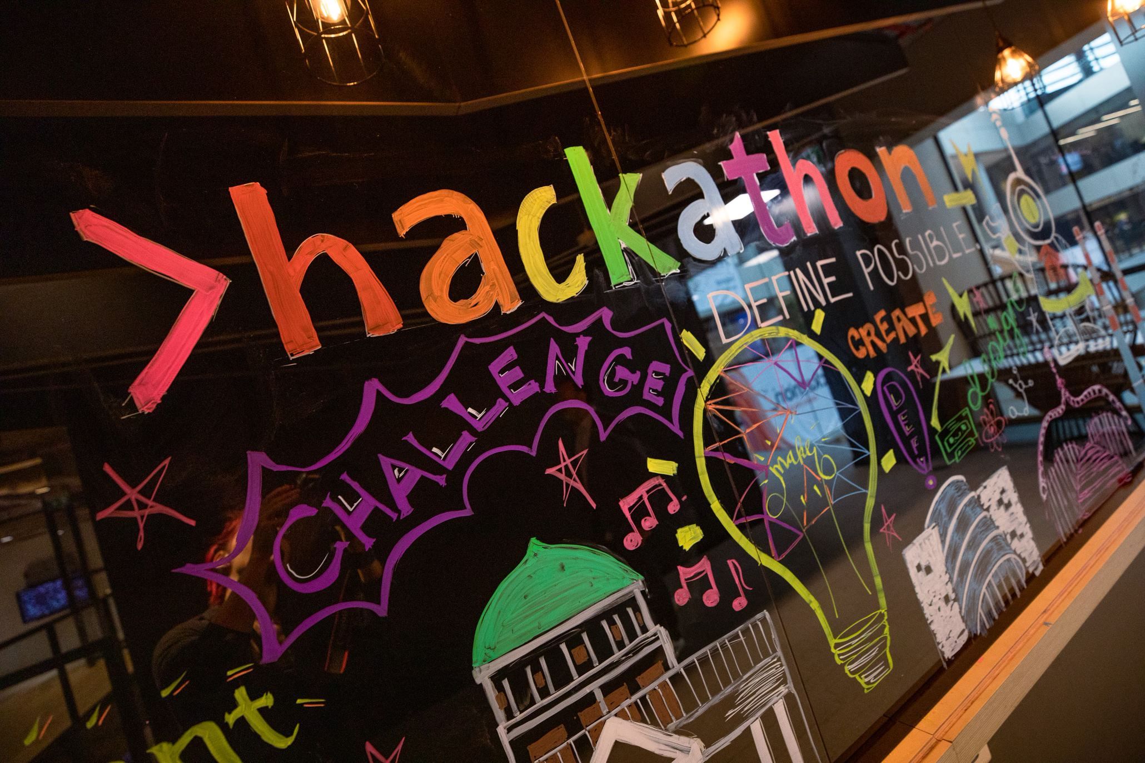
The Garage
For every employee!
The Garage drives a culture of innovation We deliver programs and experiences to our employees, customers, and ecosystem that drive collaboration, creativity, and experimentation.
In-person + virtual! Talks! Workshops! Hacks! For all roles! all skill levels!
Find out more aka.ms/garage
The Global Hackathon aka.ms/hack
The Garage Global Locations
Dublin, Ireland
Puget Sound, WA, USA
Bay Area, CA, USA
Vancouver, BC, Canada
New England, USA
New York City, NY, USA
Reston/DC, VA, USA
Atlanta, GA, USA
Herzliya, Israel
Hyderabad, India
Bengaluru, India
Beijing, China
Lagos, Nigeria
Nairobi, Kenya
SkillUp AI in The Garage
aka.ms/garage/skillupai
Produced by The Garage
Started by CEO Satya Nadella in 2014
The largest private hackathon on the planet: 73,000+ participating in 2023
For all employees
Hackers innovate in any area they want – any technologies, topics, causes, solutions
Virtual and in-person in ~60 venues worldwide
Hacking activities continue all year long in The Garage
The Microsoft Global Hackathon

Slide 3

Using AI to accelerate your Innovation
Recently, we’ve started to use AI in the innovation process within The Garage and with Hackers
Here’s how you can start to innovate using Copilot

Slide 4
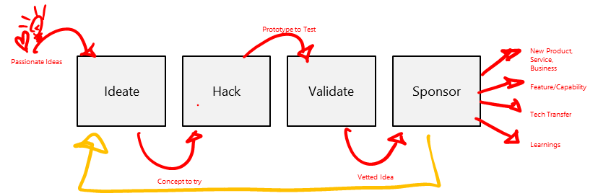
What we've learned... The Garage Growth Framework

Slide 5
Using AI to accelerate your Innovation
Let’s get started

Slide 6
What is prompting?
Text you enter when you're trying to get an AI tool to do something. It is both an art and a science. To get the best results, you need to structure your prompt in a way that the model can understand.
Like any other skill, prompting takes practice to perfect.
In general, the more specific and detailed you make your prompt, the better results you'll get.
There are five key elements to include in your prompt:
Persona: Tell the tool its job title (e.g. its role)
Objective: What do you want it to do?
Audience: Who will receive the message?
Output Parameters: Tone, style, length… let the tool know any guidelines.
Context: What points should be covered? What's the call to action?

Slide 7
Setup Setup our AI Assistant using Copilot
Act as if you are the best storyteller in the world. I want you to be my innovation coach to help reimagine and reproduce history and cultural stories for the Cherokee in the era of generative AI. Exclude AR and VR methods. The key audience you are coaching is students. Responses should be creative, push the boundaries, challenge the status quo and seek to reimagine and disrupt but educate the audience. Optimize for brevity.

Slide 8
PRE-IDEATE Setup our AI Assistant using Copilot

Slide 9
Using AI to accelerate your Innovation
Focus on a big opportunity

Slide 10

Using AI to accelerate your Innovation
The Garage Growth Framework
Prototype to Test
Passionate Ideas
Ideate
Hack
Validate
Sponsor
New Product, Service, Business
Feature/Capability
Tech Transfer
Learnings
Concept to try
Vetted Idea

Slide 11
Using AI to accelerate your Innovation
Identify an opportunity to tackle
What’s the most impactful opportunity for your team to focus on?
Why?
Could we find a sponsor internally if our prototyped resonated with people?

Slide 12
Using AI to accelerate your Innovation
Your BIG opportunity (framing)
Let’s begin with the ‘end in mind’:
Long-term ambition / goal?
Why do you want to do this?
Where do you want to be in 6 months, a year, or even five years from now?

Slide 13
Using AI to accelerate your Innovation
Your BIG idea (what you choose to explore)
How might we …..
inspire and educate students with Interactive Story Weaver
Create a digital platform where students can explore Cherokee stories through interactive, branching narratives. They can make choices that lead to different outcomes, learning about historical decisions and cultural practices along the way. This platform can use generative AI to craft new story paths, ensuring each experience is unique and engaging.

Slide 14
PRE-IDEATE: Enhance challenge/opportunity to explore
I want you to enhance and refine the strategic opportunity statement using the following framing and criteria:
The attributes of a good opportunity statement are:
Visionary, Customer-Centric, Outcome-Focused, Measurable and Urgent
Enhance the draft opportunity statement below. Give me three very different variations.
Optimise for brevity. How might we inspire and educate students with Interactive Story Weaver and create a digital platform where students can explore Cherokee stories through interactive, branching narratives. They can make choices that lead to different outcomes, learning about historical decisions and cultural practices along the way. This platform can use generative AI to craft new story paths, ensuring each experience is unique and engaging.

Slide 15
PRE-IDEATE: Enhance challenge/opportunity to explore

Slide 16
Using AI to accelerate your Innovation
Generate ideas

Slide 17
Using AI to accelerate your Innovation
The Garage Growth Framework
Prototype to Test
Passionate Ideas
Ideate
Hack
Validate
Sponsor
New Product, Service, Business
Feature/Capability
Tech Transfer
Learnings
Concept to try
Vetted Idea

Slide 18
IDEATE: Generate radical ideas to realize that huge potential
Generate 5 radical ideas to tackle the strategic opportunity statement below. The ideas should excite and energise students, be written from an engaging style, and be brief and to the point. The strategic opportunity statement is: Visionary and Customer-Centric
How might we revolutionize student engagement by creating an Interactive Story Weaver platform that immerses them in Cherokee history through AI-driven, branching narratives?

Slide 19
IDEATE: Generate radical ideas to realize that huge potential

Slide 20
IDEATE: Rate, rank, select ideas with best potential
I want you to rate and rank the 5 radical ideas. Use the following context and criteria:
Desirability: Does the idea show a deep understanding of the customer’s needs, wants, and limitations?
Opportunity Relevance: Does the idea address a significant problem or challenge faced by the customer?
Innovation Level: Is the idea new and creative, or is it a replication of existing solutions?
Feasibility: Can the product or service be built? Can the idea be quickly turned into a prototype for testing?
Market Opportunity: Is there a market for this idea? What is the estimated TAM and are there potential customers willing to pay for this idea.
Apply that criteria to the 5 radical ideas and score each idea on each criterion on a scale of 0 to 5, where 0 is lowest and 5 is highest, and rank them in a table.

Slide 21
IDEATE: Rate, rank, select ideas with best potential

Slide 22
Using AI to accelerate your Innovation
Hack together something to test out the idea

Slide 23
Using AI to accelerate your Innovation
The Garage Growth Framework
Prototype to Test
Passionate Ideas
Ideate
Hack
Validate
Sponsor
New Product, Service, Business
Feature/Capability
Tech Transfer
Learnings
Concept to try
Vetted Idea

Slide 24
HACK: Protype storyboard
list 3 cherokee stories and customs, songs and proverbs, and incorporate these stories into our Time Travel Adventure initiative? Explain their uniqueness

Slide 25
HACK: Protype storyboard
To help tell the stories, generate a 6-panel storyboard outline. The storyboard should be specific to the stories and customs above. The storyboard should be designed to help create a demo video.The storyboard outline should include a voice-over for each panel. Represent the storyboard in a table format.
Optimise for brevity.

Slide 26
HACK: Prototype storyboard

Slide 27
HACK: Create storyboard images
Create an image in the style of a storyboard sketch for panel 1

Slide 28
HACK: Create storyboard images
Create an image that represents the Cherokee tribe

Slide 29
Using AI to accelerate your Innovation
Test out the idea

Slide 30
Using AI to accelerate your Innovation
The Garage Growth Framework
Prototype to Test
Passionate Ideas
Ideate
Hack
Validate
Sponsor
New Product, Service, Business
Feature/Capability
Tech Transfer
Learnings
Concept to try
Vetted Idea

Slide 31
Using AI to accelerate your Innovation
Secure a sponsor

Slide 32
Using AI to accelerate your Innovation
The Garage Growth Framework
Prototype to Test
Passionate Ideas
Ideate
Hack
Validate
Sponsor
New Product, Service, Business
Feature/Capability
Tech Transfer
Learnings
Concept to try
Vetted Idea

Slide 33
SPONSOR: Generate an outline for a sponsor pitch deck
For the final idea create a specific PowerPoint pitch deck outline with slides explaining the Cherokee Stories and customs, songs and proverbs and you plan to expose students to it using the Time Travel Adventure initiative. Tone should be engaging in order to capture interest and awareness from the audience. Be specific to the final idea and incorporate any relevant facts and market data.
Optimise for brevity.

Slide 34
SPONSOR: Generate an outline for a sponsor pitch deck

Slide 35
What we’re learning …
Promote Divergent Thinking
Generate lots of wild ideas, cross associate,
Challenge Expertise Bias
Produce atypical ideas and designs that humans would never imagine using traditional methods
Assist in Idea Evaluation
Evaluating lots of ideas, combining them
Support’s idea refinement
Combine / merge a large number of ideas to produce stronger ones
Communicate ideas for collaboration and sponsorship
Assist communicating ideas in written, visual, video and pitch deck form
Beginning to truly democratises innovation
Assists everyone in their individual and collective efforts to create hitherto unimaginable solutions.

